Slide 1
TOPIC
LENGTH OF AN ARC
and
AREA OF SURFACE OF REVOLUTION

Slide 2
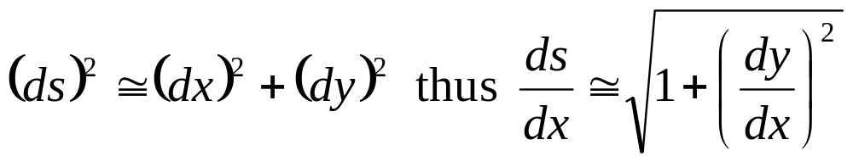
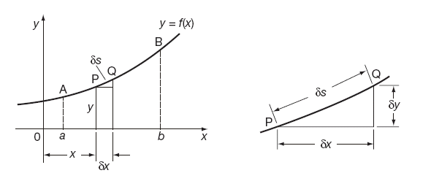
LENGTHS OF CURVES
To find the length of the arc of the curve y = f (x) between x = a and x = b let ds be the length of a small element of arc so that:

Slide 3
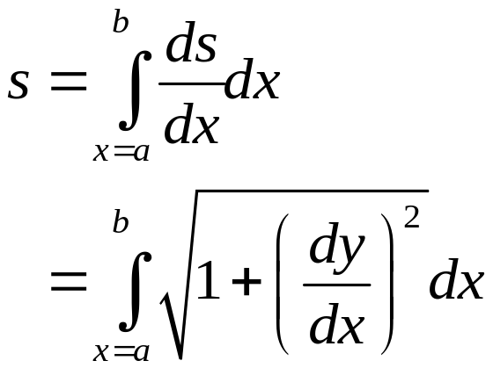
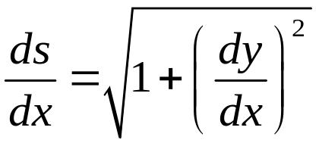

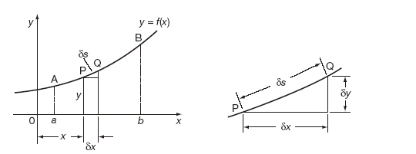
LENGTHS OF CURVES
In the limit as the arc length ds approaches zero:
and so:

Slide 4
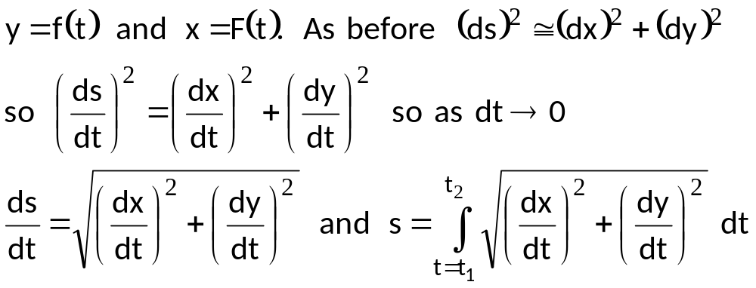
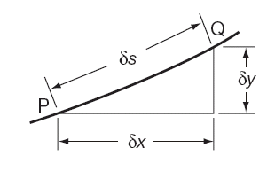
LENGTHS OF CURVES – PARAMETRIC EQUATIONS
Instead of changing the variable of the integral as before when the curve is defined in terms of parametric equations, a special form of the result can be established which saves a deal of working when it is used.
Let:

Slide 5
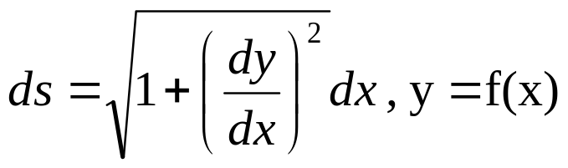
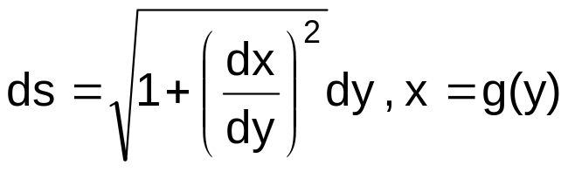
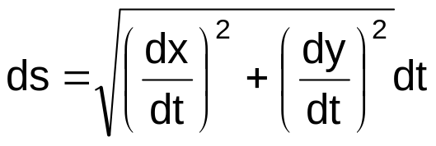
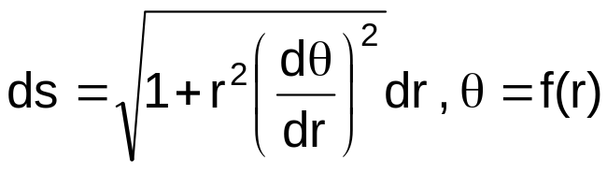
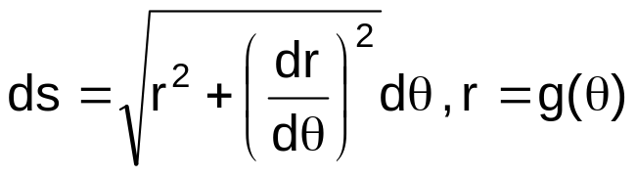
LENGTH OF AN ARC
A. Rectangular Coordinates
1.
2.
B. Parametric Form
when x=x(t), y=y(t); where t is a parameter
C. Polar Coordinates
1.
2.

Slide 6
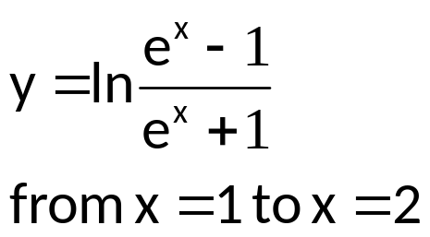
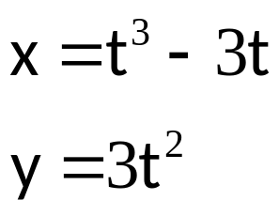
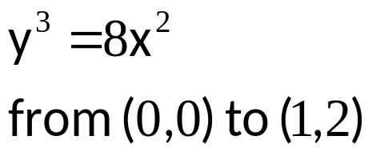
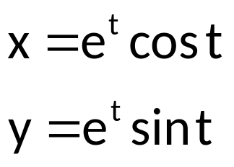
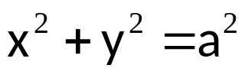
EXAMPLE
Find the length of the arc of each of the following:
1.
3.
from t=o to t=1
4.
2.
5. Length of the arc of the semicircle
from t=o to t=4

Slide 7
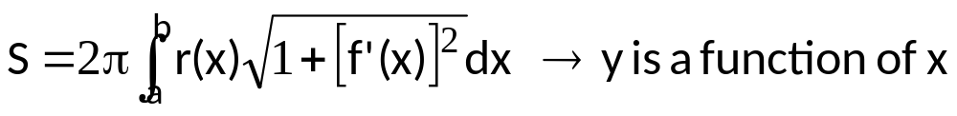
AREA OF SURFACE OF REVOLUTION
DEFINITION:
Let y = f(x) have a continuous derivative on the interval [a, b]. The area S of the surface of revolution formed by revolving the graph of f about a horizontal or vertical axis is
where r(x) is the distance between the graph of f and the axis of revolution.

Slide 8
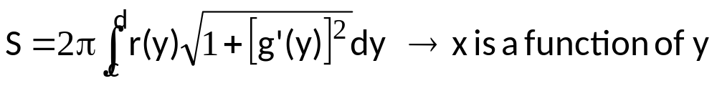
If x = g(y) on the interval [c, d], then the surface area is
where r(y) is the distance between the graph of g and the axis of revolution.

Slide 9


EXAMPLE
Find the area formed by revolving the graph of f(x) = x³ on the interval [0,1] about the x-axis.
Find the area formed by revolving the graph of f(x) = x² on the interval [0, ] about the y – axis.
Find the area of the surface generated by revolving the curve
, 1 ≤ x ≤ 2 about the x – axis.
4. The line segment x = 1 – y, 0 ≤ y ≤ 1, is revolved about the y – axis to generate the cone. Find its lateral surface area.

